Slide 1
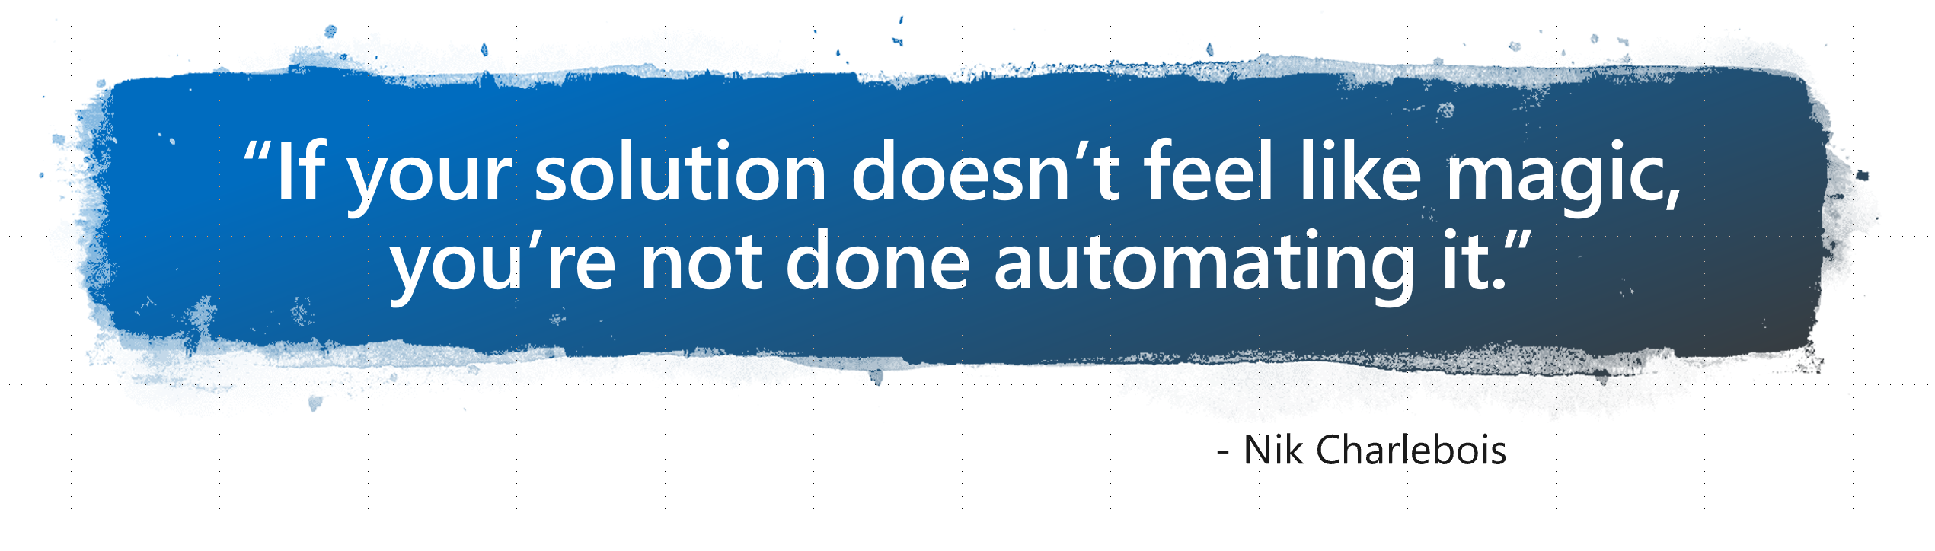
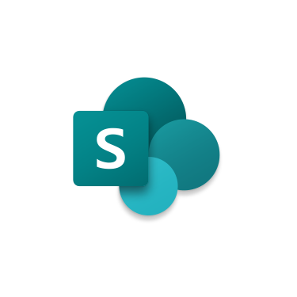
DevOPS for SharePoint Admins
Concrete Scenarios

Slide 2

Meet Nik ‏@NikCharlebois
Microsoft Senior Premier Field Engineer
Focusing on SharePoint Development and Automation
Overall DevOPS evangelist
About Me
Ex-PowerShell MVP
Author of the books Beginning PowerShell for SharePoint 2013 and 2016 & Office 365 Experts
Based in Gatineau, Quebec
Frequent Conference Speaker
Blogger at http://NikCharlebois.com
Co-Owner of SharePointDSC and Owner of Office365DSC & ReverseDSC

Slide 3
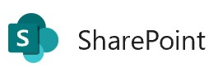
Setting the Expectations
Focus is on 2019 On-Prem deployed to Azure (but applicable to 2013 & 2016);
Some prior knowledge of PowerShell Desired State Configuration (DSC) will help;
Session will use “hosted” Azure DevOPS, but works the same for on-premises;
Not a Deep-Dive; Overview of what DSC for SharePoint is and what scenarios it solves for DevOPS;

Slide 4
Agenda
Overview of PowerShell DSC;
Intro to Azure Automation
Overview SharePointDSC and Office365DSC;
Overview of ReverseDSC for SharePoint;
Azure DevOPS Integration scenarios;

Slide 5
Desired State Configuration

Slide 6

What is PowerShell DSC (10,000 Feet View)
Automate configuration and monitoring of environments;
Make sure environments stay in their “desired” configurations (no configuration drifts);
PowerShell 4.0 and above (SP2010 not supported);

Slide 7
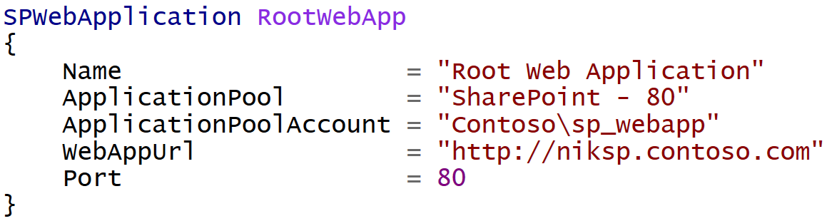
Difference from “Classic” PowerShell
It is a Declarative approach;
Notes:
Meaning I don’t tell it do this and then that, but rather here is how I want this, then do whatever in you need to to get me there

Slide 8
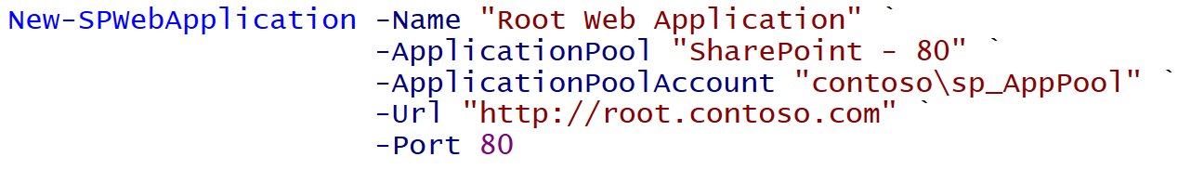
Imperative
Declarative
Notes:
Same result. Yes more lines in this example, but ensures it stays in that state.

Slide 9
Monitoring for Config Drifts
Configuration Modes:
ApplyOnly
ApplyAndMonitor
ApplyAndAutoCorrect

Slide 10
Monitoring for Config Drifts
Configuration Modes:
ApplyOnly
ApplyAndMonitor
ApplyAndAutoCorrect
Configure the server as defined, then done;
Equivalent of using sequential scripts or AutoSPInstaller.

Slide 11
Monitoring for Config Drifts
Configuration Modes:
ApplyOnly
ApplyAndMonitor
ApplyAndAutoCorrect
Monitor for configuration drifts;
Create entries in Event logs for drifts.

Slide 12
Monitoring for Config Drifts
Configuration Modes:
ApplyOnly
ApplyAndMonitor
ApplyAndAutoCorrect
Monitor for configuration drifts;
Repairs drifts automatically.

Slide 13
Ensuring State
DSC is not just about ensuring a configuration is applied;
Every resource have the Ensure parameter exposed;
Setting Ensure = Absent will always make sure things are not configured;
SPServiceInstance SearchAdmin
{
Name = "WSSSearch"
Ensure = "Absent"
}

Slide 14
Demo 1
File Management

Slide 15
Azure Automation

Slide 16
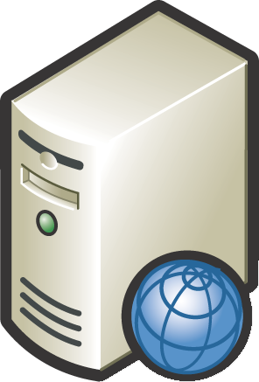

Pull Server
Central server that stores all configurations for your enterprise (e.g. WFE, SQLServer, DC, etc.)c
Pull Server

Slide 17
Pull Server
Central server that stores all configurations for your enterprise (e.g. WFE, SQLServer, DC, etc.)
Pull Server

Slide 18

Overview of AADSC
Pull Server as a Service;
Included as part of an Azure Automation Account;
Free when used with Azure VMs;

Slide 19

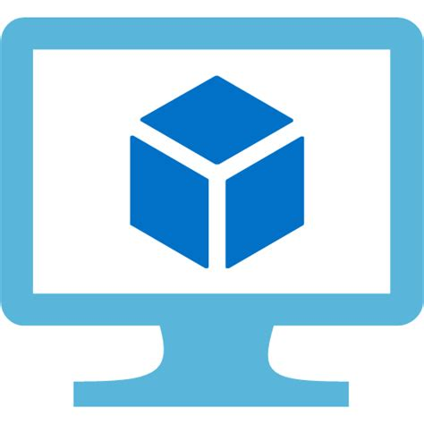
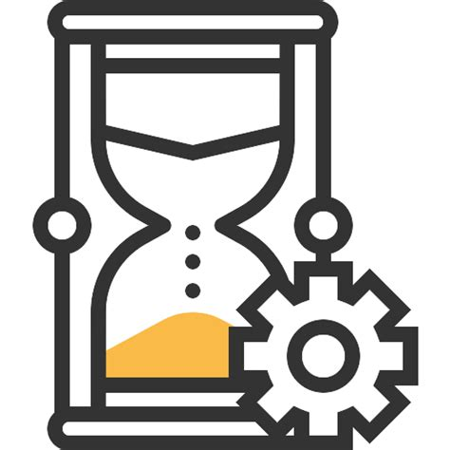
Overview of AADSC[…]
Azure Virtual Machine
DSC Script
Azure Automation

Slide 20
Demo 2
Azure Automation - Firewall Rule

Slide 21

DSC Modules
Macro Components to extend DSC (e.g. SharePointDSC, SQLServerDSC, etc.)
All available on the PowerShell Gallery (http://PowerShellGallery.com)
Need to be install on all servers in the farm;

Slide 22

SharePointDSC
Support configuring everything that is in Central Admin….and even sites;
Over 114 components supported;
Community project, lead by Microsoft engineers from across the globe;
Aka.ms/SharePointDSC

Slide 23



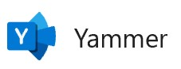



Office365DSC
Supports automation of all Workloads:
PowerApps
Flow […]
Still in Alpha version at this time. Anticipated release around SPCNA in May;
Aka.ms/Office365DSC

Slide 24
Office365DSC
#region SharePoint Online
SPOSite CollabSummit
{
Url = "https://office365dsc.sharepoint.com/sites/CollabSummit"
Title = "CollaborationSummit"
Owner = "admin@Office365DSC.onmicrosoft.com"
StorageQuota = 100
CentralAdminUrl = "https://office365dsc-admin.sharepoint.com"
GlobalAdminAccount = $GlobalAdmin
Ensure = "Present"
}
#endregion
#region Teams
TeamsTeam CollabSummit
{
DisplayName = "Collab Summit"
Description = "This is me demoing the Teams Resource"
GlobalAdminAccount = $GlobalAdmin
Ensure = "Present"
}
TeamsChannel DSCChannel
{
TeamName = "Collab Summit"
DisplayName = "DSC Discussions"
GlobalAdminAccount = $GlobalAdmin
Ensure = "Present"
}
#endregion

Slide 25
Demo 3
Office365DSC

Slide 26
Azure Resource Manager

Slide 27

Overview of Azure Resource Manager (ARM)
.JSON file that defines the components of our VMs;
Used to automate the deployment of our SharePoint Farm VMs in Azure;
Can obtain .JSON file from the VM creation wizard in the Azure Portal;

Slide 28


ARM Templates
Editor available in VS Code;
Azure exposes an endpoint to allow One-Click Deployments;
Ability to use ARMViz to visualize the components of the template;

Slide 29

Proof-of-Concept - Goals
Manage Configuration as code in Azure DevOPS;
Continuous Integration and Deployment of Configuration changes;
Promote changes from Dev all the way up to prod;
Keep environments (tenants) in Sync;

Slide 30
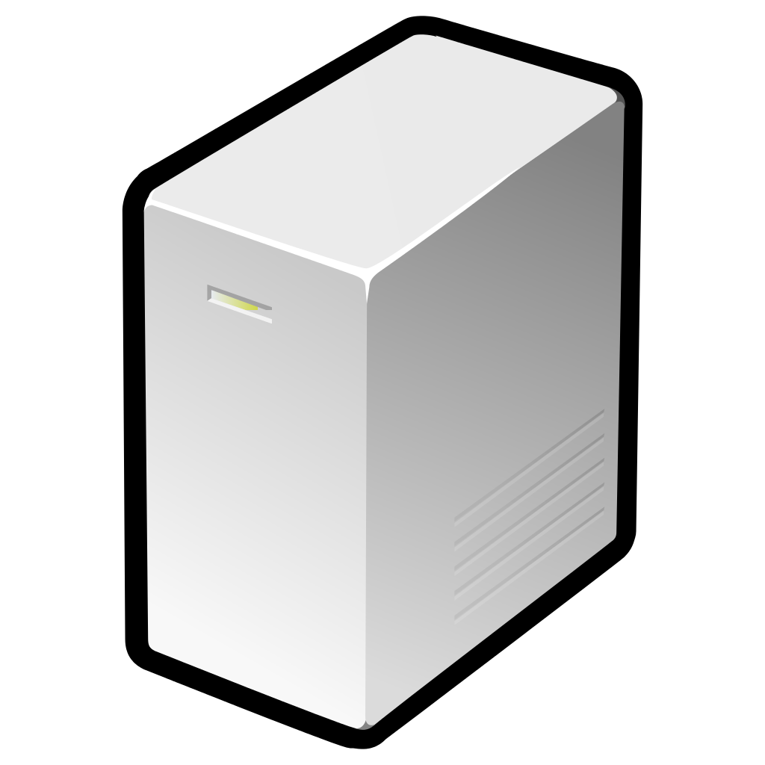
Scenario – Dev Environment
SharePoint 2019
(Web Front-End)
Domain Controller
(contoso.com)
SQL 2017
SharePoint 2019
(Application)
SharePoint 2019
(Search)

Slide 31


Proof-of-Concept - Components
SharePoint 2019 Dev Farm
Azure
ARM Templates
Azure DevOPS
DevOPS Repo & Pipelines
Git Source Control*
Azure Automation
Azure
DSC Scripts
ARM is Infrastructure as code
DSC is Configuration as code
* Would work just fine with a TFS repo

Slide 32


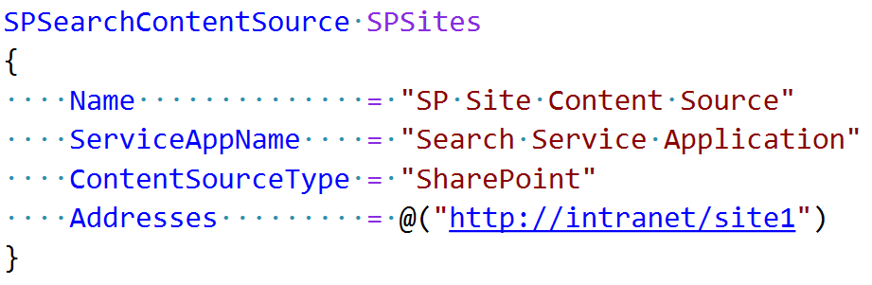

Proof-of-Concept – Typical Scenario
IT Admin opens Visual Studio Code, adds a DSC block to define the new content source.
IT Admin
Azure DevOPS
Upon successful build, VSTS pushes the DSC script to Azure Automation using an Azure PowerShell task within the Release Definition.
Azure Automation DSC pushes the changes to the Dev environment.
IT Admin commits the change back to VSTS.
VSTS Initiates a new Dev Build.
IT Admin wants to add a new Search Content Source to the Environment.
Azure Automation
SharePoint Dev Farm

Slide 33
ReverseDSC

Slide 34

Anatomy of a DSC Resource
Test-TargetResource -> Am I in my Desired State?
Get-TargetResource -> How am I currently configured?
Set-TargetResource -> Here is how I want you to configure me!

Slide 35
ApplyAndAutocorrect Flow

Slide 36

Key Takeaway
Every Resource must contain a Get-TargetResource function;
The Get-TargetResource function returns the representation of the Current State for an instance of a given Resource;
The secret sauce of the ReverseDSC process lies in the Get-TargetResource function;
Notes:
ReverseDSC for a Module is only as good as its Get-TargetResource functions;

Slide 37

SharePointDSC.Reverse
Extracts a PowerShell DSC script that represents the current state of any given SharePoint 2013+ farm;
Available in the PowerShell Gallery
Install-Script SharePointDSC.Reverse

Slide 38
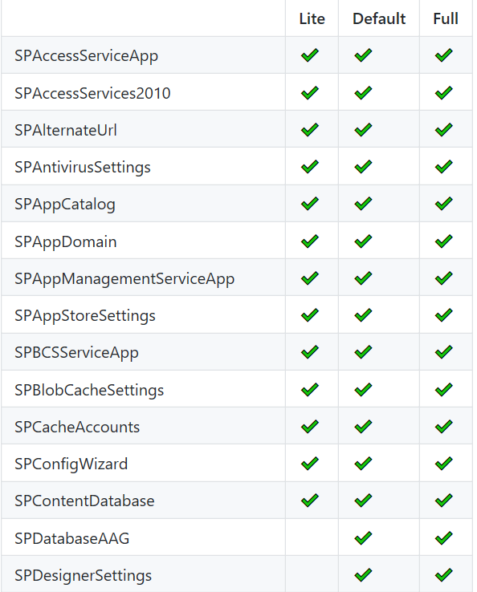
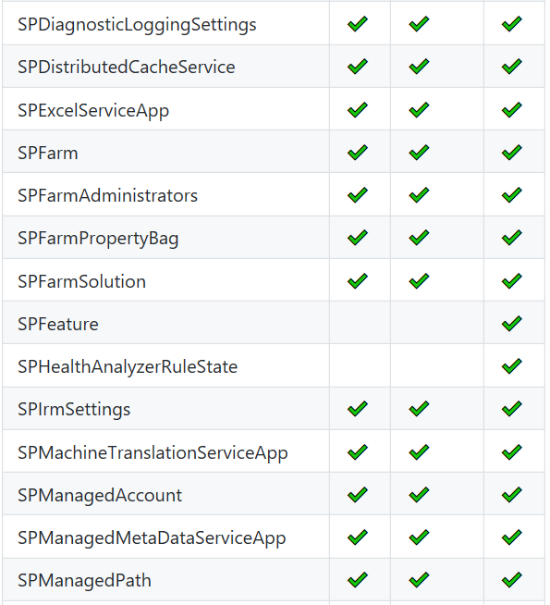
Extraction Modes
-Mode:[Lite|Default|Full]
…

Slide 39
Additional Switches
-SkipSitesAndWebs does not scan Site Collections and Webs;
-Standalone combines the output DSC script into a Standalone SharePoint Server representation;
-OutputFile specifies the full path (including .ps1) where the output will be generated;
-Azure Uses Azure Automation Credentials, and generates an automated Deployment Script;

Slide 40
Possibilities
Document your existing farms as DSC;
Replicate your farms on-premises or in Azure (Disaster Recovery, DevOPS);
Quick Proof of concept upgrade from 2013 to 2016;
Onboard existing environments onto DSC;

Slide 41
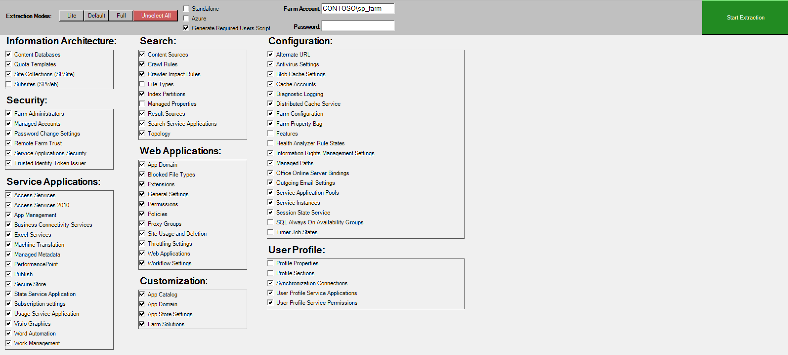

Slide 42
Demo 4
ReverseDSC in Action

Slide 43
Questions

Slide 44
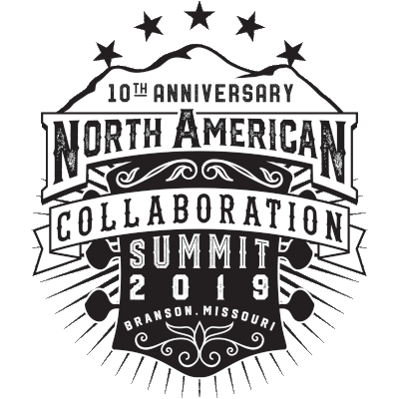







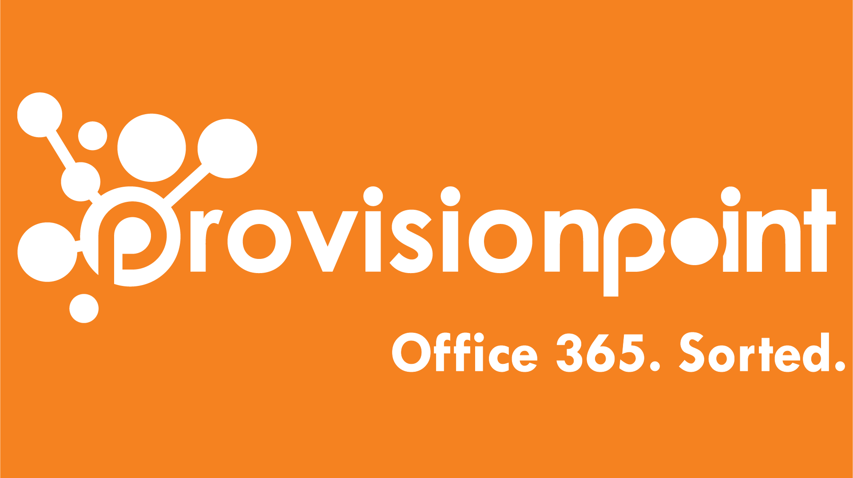

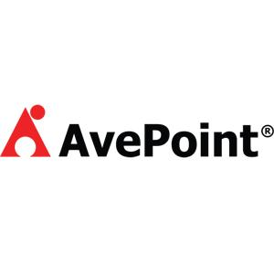
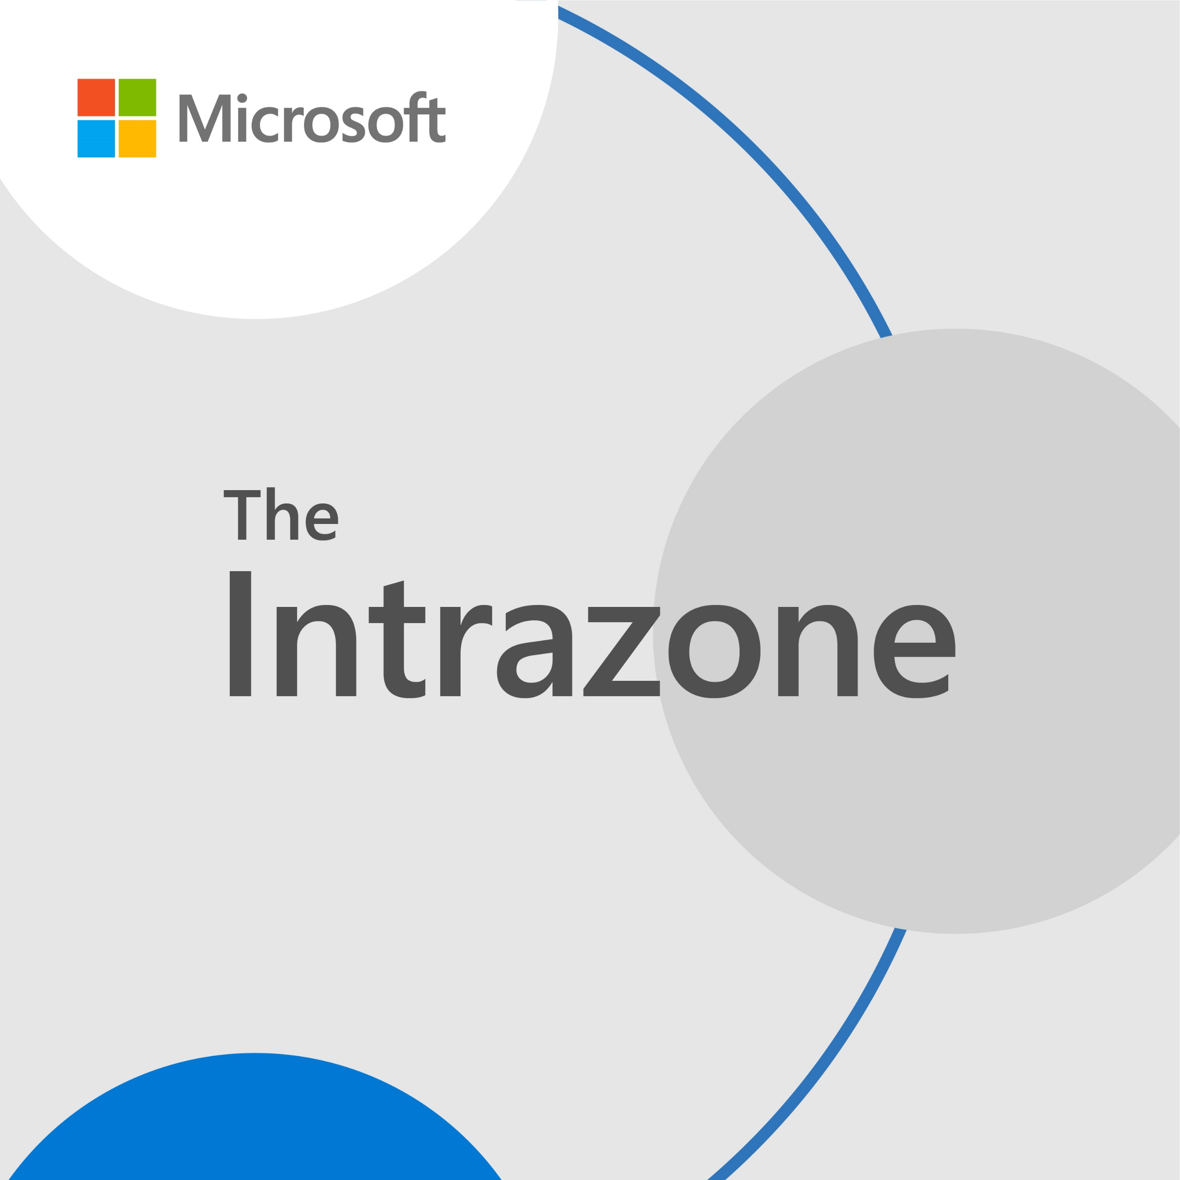
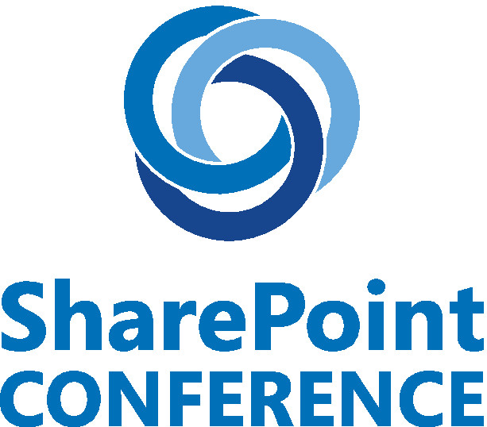

Be Sure To Thank Our Sponsors!

Slide 45

Win a Surface Book courtesy of Microsoft!
Play Vendor Bingo, Winner drawn during closing session on Friday

